Slide 1


CSSEA 2026 AGM and Conference
AI and the Law
October 15, 2026
Matthew Cooperwilliams & Joshua Ghatak
Cooperwilliams Truman & Ito LLP

Slide 2
Agenda
I.
Patchwork of Provincial AI Legislation
II.
AI and Human Rights and Privacy Risk in B.C.
III.
AI in Employment Litigation: Discovery and Privilege

Slide 3

I. AI Legislation
        B.C.
        Ontario
        Alberta
        Manitoba
        Quebec

Slide 4
B.C. Legislation (or lack thereof)
The B.C. Employment Standards Act does not contain any provisions that specifically address AI
The use of AI may create legal risk through other legislation, e.g. PIPA and Human Rights Code
Some jurisdictions in Canada address AI through employment standards legislation or privacy legislation
Can legislation from other jurisdictions foreshadow future B.C. legislation?
Can we anticipate what features B.C. might use in future legislation based on other jurisdictions?

Slide 5
Ontario Employment Standards Act, 2000
Effective January 1, 2026 - ESA section 8.4(1): “Every employer who advertises a publicly advertised job posting and who uses artificial intelligence to screen, assess or select applicants for the position shall include in the posting a statement disclosing the use of the artificial intelligence.” [emphasis added]
Ontario Ministry Website: “If an employer uses artificial intelligence to screen, assess or select applicants for a publicly advertised job posting, the employer must disclose the use of the artificial intelligence in the posting. This requirement applies equally where the employer engages a third party (for example, a recruiting firm) … It is unnecessary to provide a detailed description of the artificial intelligence system or the employer’s use of the system. It is enough for the employer to state that artificial intelligence is used to screen, assess or select applicants”
Ontario employers will have to (1) update job postings to include AI disclosure statement; and (2) decide content of statement
Less is more or voluntary transparency?
Notes:
Section 8.4 applies to employers with 25 or more employees on the day a publicly advertised job posting (some exclusions)
ESA Regulation: ““artificial intelligence” means a machine-based system that, for explicit or implicit objectives, infers from the input it receives in order to generate outputs such as predictions, content, recommendations or decisions that can influence physical or virtual environments”
There is no statutory definition of “screen”, “assess”, or “select”. Reasonable to use ordinary meaning.
An Ontario employer cannot offload this obligation to a recruiter.

Slide 6
Alberta – Privacy Legislation
Alberta uses privacy legislation rather than employment standards legislation to address “automated systems”
Alberta’s Protection of Privacy Act (applies to public bodies). Similar to B.C.’s Freedom of Information and Protection of Privacy Act (FOIPPA)
Section 5(2) requires a public body that intends to use personal information in an “automated system” to “generate content or make decisions, recommendations, or predictions” to notify the individual of that intention at the time of collection
Section 6: If an automated system makes a decision that “directly affects” someone, the public body must make “every reasonable effort to ensure the information is accurate and complete” and retain the personal information for at least one year after its use
Notes:
See similarity in AB definition of “automated system” and ON definition of “artificial intelligence. Generating predictions and decisions or advice/recommendations based on inputs. No named platform or entity.
AB legislation has a record-keeping obligation. Data retention internally for Employers could be onerous. Everyone’s internal chat logs?

Slide 7
Alberta – Takeaways and Questions
Public sector obligation to:
          Notify of intention to use “automated system”
          Make every reasonable effort to ensure accurate and complete information
          Retain personal information for at least a year
        Questions:
          What does “directly affects” mean?
          How can an employer guarantee “accurate and complete” information?
          How onerous is “every reasonable effort”?
Notes:
How and when to notify people?

Slide 8
  Manitoba – Bill 51
Public Sector Artificial Intelligence and Cybersecurity Governance
Received Royal Assent on June 1, 2026. Not yet proclaimed into force
Creates a framework for regulating AI and cybersecurity in Manitoba’s public sector. Its substantive obligations are left for future regulations
Notes:
MB is a helpful example of a standalone piece of legislation. It’s not built into a pre-existing framework. It is its own piece.

Slide 9
  Manitoba – Bill 51
Sections 4-6 require public sector entities to:
      Provide information about use of AI
      Develop and implement an “accountability framework” about use of AI
      Take steps to “manage risks” associated with their use of AI
      Restrict use of AI to only those uses permitted by legislation
      Ensure that an “individual” exercises oversight of the use of AI
    Section 10(1)(f): A regulation may be made prohibiting the use of AI for the “production of artistic or creative material”
Notes:
MB is a helpful example of a standalone piece of legislation. It’s not built into a pre-existing framework. It is its own piece.

Slide 10
  Quebec Privacy Legislation
An Act respecting the protection of personal information in the private sector
12.1 Any person carrying on an enterprise who uses personal information to render a decision based exclusively on an automated processing of such information must inform the person concerned accordingly not later than at the time it informs the person of the decision. He must also inform the person concerned, at the latter’s request,
          of the personal information used to render the decision;
          of the reasons and the principal factors and parameters that led to the decision; and
          of the right of the person concerned to have the personal information used to render the decision corrected.
        Distinction between decisions made by AI “exclusively” vs. human oversight would reduce burden on employers and deter employers from offloading decisions completely
Notes:
“Automated processing” is not defined in Quebec’s legislation.
Quebec approach may be derived from EU General Data Protection Regulation Article #22 “Automated Individual Decision-making”
Degree of AI’s influence on decision is deciding factor in Quebec privacy legislation

Slide 11
How B.C. Legislation Might Change
Forcing employers to disclose intended or actual use of AI in:
          Screening, assessing, and selecting job applicants and during recruitment
          Internal decision-making during employment
          Stating the degree of AI’s influence on decisions (exclusive or not)
Requiring employers to:
          Ensure accuracy and completeness of information uploaded to AI
          Retain records of how they use personal employee information and AI together
          Restrict usage of AI in certain ways
        Could obligations depend or change based on employer size and nature (private or public)?

Slide 12
Which Legislation B.C. Might Use
Appropriate legislation may depend on topic:
    Hiring and recruiting could be the Pay Transparency Act
    Regulating terms and conditions of employment could be the Employment Standards Act
    Privacy and employee personal information could be privacy legislation
    Discrimination by AI could be the Human Rights Code
Notes:
Could BC get its own standalone legislation dedicated to AI?

Slide 13

II. AI and Human Rights and Privacy Risks
AI and its potential discriminatory bias
Disclosing personal employee information to AI

Slide 14
  Human Rights - Test for Discrimination
The prima facie test for discrimination is relatively easy to meet. A human rights complaint may be an appealing route for an unsuccessful job candidate.
Moore v. British Columbia (Education) 2012 SCC 61:
The person has a characteristic protected by the Human Rights Code;
The person experienced an adverse impact with respect to their employment; and
The protected characteristic was a factor in the adverse impact

Slide 15
  Section 13 –
  Protected Grounds in Employment
Indigenous identity
Race
Colour
Ancestry
Place of origin
Political belief
Religion
Marital status
Family status
Physical or mental disability
Sex
Sexual orientation
Gender identity or expression
Age
Convicted of a criminal or summary conviction offence that is unrelated to the employment or to the intended employment of that person

Slide 16
  How AI Creates Human Rights Risks
“Where existing systemic discrimination, bias, and exclusion are embedded in data and systems design, AI systems replicate inequalities and existing barriers and exclude diverse communities.” Canadian Human Rights Commission
Potential Risk: Your inputs and instructions to avoid or prefer candidates could cause AI to disproportionately screen out certain job candidates. If AI adversely impacts candidates in part because of a protected characteristic, the resulting decision and pattern could be discriminatory. AI inputs and outputs may favour traditionally gender-specific or demographic-specific training, language or speech patterns, skills, or work experience
Human rights law does not care if discrimination was intentional or inadvertently caused by AI

Slide 17
  USA Examples
EEOC v. iTutorGroup: Case brought by the Equal Employment Opportunity Commission. Software automatically rejected female applicants aged 55 or older and male applicants aged 60 or older. A candidate submitted identical applications, but with different birth dates, and only the younger one received an interview. The software functioned on an age filter, rather than machine learning. $365,000 USD settlement paid to rejected applicants; 200+ allegedly screened out.
Mobley v. Workday, Inc.: Ongoing class action about whether an AI vendor, not just the employer, can be liable for discriminatory hiring. Mobley sued Workday, not the employers, arguing that Workday acted as the employers' "agent“ and that Workday's AI screening platform discriminated on the basis of race, age and disability. Still in pre-trial proceedings
Elegant Enterprise-Wide Solutions: In February 2026, the U.S. DOJ settled allegations that Elegant Enterprise-Wide Solutions used an AI tool to generate job ads that limited applicants to certain visa holders, unlawfully screening out U.S. workers
Notes:
EEOC Case described as the EEOC's first "AI hiring" settlement
WorkDay ats. Mobley
The court accepted that Mobley alleged a "unified policy": "the use of Workday's AI recommendation system to score, sort, rank, or screen applicants".
It rejected Workday's argument that the tool's impact varies from one employer-client to another. Workday's position that its AI merely implements employer preferences was left for a later stage
Commentators describe the case as ending both "that's the vendor's problem" for employers and "we only make the software" for vendors.
DOJ-ELEGANT
The company agreed to a civil penalty, new policies, staff training and three years of DOJ monitoring, a reminder that employers are responsible for discriminatory content "no matter who — or what — drafts a job advertisement".
The DOJ alleged that Elegant's AI-generated job ads required applicants to hold H-1B, OPT or H-4 visas, in violation of the Immigration and Nationality Act. Listing work-authorization visas as a requirement "would have the effect of screening out US workers". A visa-only requirement excludes:
U.S. citizens;
lawful permanent residents (green-card holders); and
refugees and asylees, a group earlier DOJ settlements also treated as wrongly excluded
In the IT staffing sector, visa-holder-only postings have often been linked to a preference for workers who are cheaper or more tied to their employer.

Slide 18
  Ontario’s AI Impact Assessment Tool
Human Rights AI Impact Assessment Tool (“HRIA”)
The HRIA is a two-part questionnaire
Questions 1-13 try to assess whether your AI system poses a high risk of engaging in discrimination
Questions 14-22 address (1) Which communities are impacted by an AI system; and (2) Whether the AI system demonstrates differential treatment among or within a community
Notes:
The Law Commission of Ontario and the Ontario Human Rights Commission created HRIA for organizations to use in identifying, assessing, minimizing, and avoiding discrimination while using AI
Additional questions try to determine whether the AI system considers specific communities and makes necessary accommodations and addressing auditing and internal review steps

Slide 19
  Examples from the Questionnaire
Q12: What are the demographics of the people who are subjected/exposed to the AI system? E.g. socio-economic status, geographic location, demographic
Q15: Does the AI system produce results that differentiate based on one or more protected grounds?
Q16: Have you tested or validated the AI system to see what factors it relies on?
Q17: Does the AI system assign characteristics to individuals based on proxies and other available data? Does the system produce outputs based on personal characteristics of individuals that are assumed, and not explicitly available in data?
Q22: Is there a justifiable reason for why the system is showing differential treatment? What steps have been taken to minimize or address the human rights harms?
Notes:
Q12: Think about the hiring pool. What are the characteristics of the most common applicants? Are there any? Do they overlap with a protected human rights ground?
Q15: Does the AI system target, directly or indirectly, people based on one or more of the protected grounds of discrimination? Are specific communities over- or under-represented in the results of the AI system?
Q16: This is an auditing question. Does AI rely on factors that correlate with a protected ground? Have you ever tested the AI? It tries to determine whether any of the factors or combination of factors correlated with a protected human rights ground
PROXIES: Proxies that have been discovered in AI systems include postal code as a proxy for race where neighbourhoods have high concentrations of a particular racial group; gaps in work experience as a proxy for women because women are more likely to take time off for childcare; and playing competitive sports as a proxy for men because men are more likely to have played a competitive sport.
Q17: Question 16 asks you to test/validate the AI system for the factors it is relying on and to consider whether these factors are proxies for protected grounds. This question asks you to consider whether the AI is attaching/assigning information to the individuals that is not explicitly in the data. Does the technical system rely on a statistical model of human behaviour or personal characteristic?
Q22: Is the AI system meeting its intended objective(s)? Is the need/requirement to use the AI system pressing enough to outweigh the negative impact of the AI system?

Slide 20
  Avoiding Discriminatory AI Determinations
Talk to your AI vendor. Ask:
          What data is your AI system trained on?
          Is your AI system audited for bias?
          What steps (if any) has the vendor taken to address or incorporate Canadian human rights law?
          How will the AI system uphold human rights principles?
Ensure human oversight and be able to explain your decision. Don’t offload entirely to AI
Notes:
Limit the use of AI. For example, have AI identify only must-have credentials during hiring
Try Ontario’s HRIA Tool
AI should not be “exclusively” or “solely” responsible for screening or hiring candidates

Slide 21
  AI and B.C. PIPA
Personal Information Protection Act
1: “employee personal information" means personal information about an individual that is collected, used or disclosed solely for the purposes reasonably required to establish, manage or terminate an employment relationship between the organization and that individual, but does not include personal information that is not about an individual's employment
The three pillars of PIPA: Collection, Use, Disclosure
13(3): “An organization must notify an individual that it will be collecting employee personal information about the individual and the purposes for the collection before the organization collects the employee personal information without the consent of the individual.”
Similar notification obligations about Disclosure and Use in Sections 16 and 19

Slide 22
  PIPA Risks Arising From AI
PIPA permits an employer to collect, use, and disclose employee personal information for the purposes of establishing, managing, or terminating an employment relationship
Consent of the employee (or job candidate) is not required for the above, but advance notice about the collection, use, and disclosure of employee personal information and the purpose of that collection, use, and disclosure is
B.C. OIPC has general statements about the use of AI. Nothing specific about whether PIPA requires B.C. employers to mention using AI in hiring or human resources practices
Notes:
Should B.C. private sector employers be notifying job candidates and current employees about intended use of AI to establish, manage, or terminate employment?

Slide 23
  Risks In Labour and Unionized Context
Privacy and Surveillance: Collective agreements and arbitral case law can add privacy protections. AI may be scrutinized as increased employee surveillance or productivity measures.
Erosion of bargaining unit work: Could AI performing bargaining unit work give rise to disputes similar to contracting out?
Joint Consultation: B.C. Labour Relations Code section 53. If requested, a consultation committee between employer and union will meet every two months to discuss workplace issues. Purposes include “to respond and adapt to changes in the economy, to foster the development of work related skills and to promote workplace productivity”
Technological Change: B.C. Labour Relations Code section 54 (“Adjustment Plan”) requires 60 days’ notice of change that affects a “significant number of employees” and that the employer and trade union meet “in good faith” and “endeavour to develop an adjustment plan”, with mediation as a possible recourse
Notes:
Collective agreement may address all these points. Check your CBA to see how the application of AI may overlap or impact

Slide 24
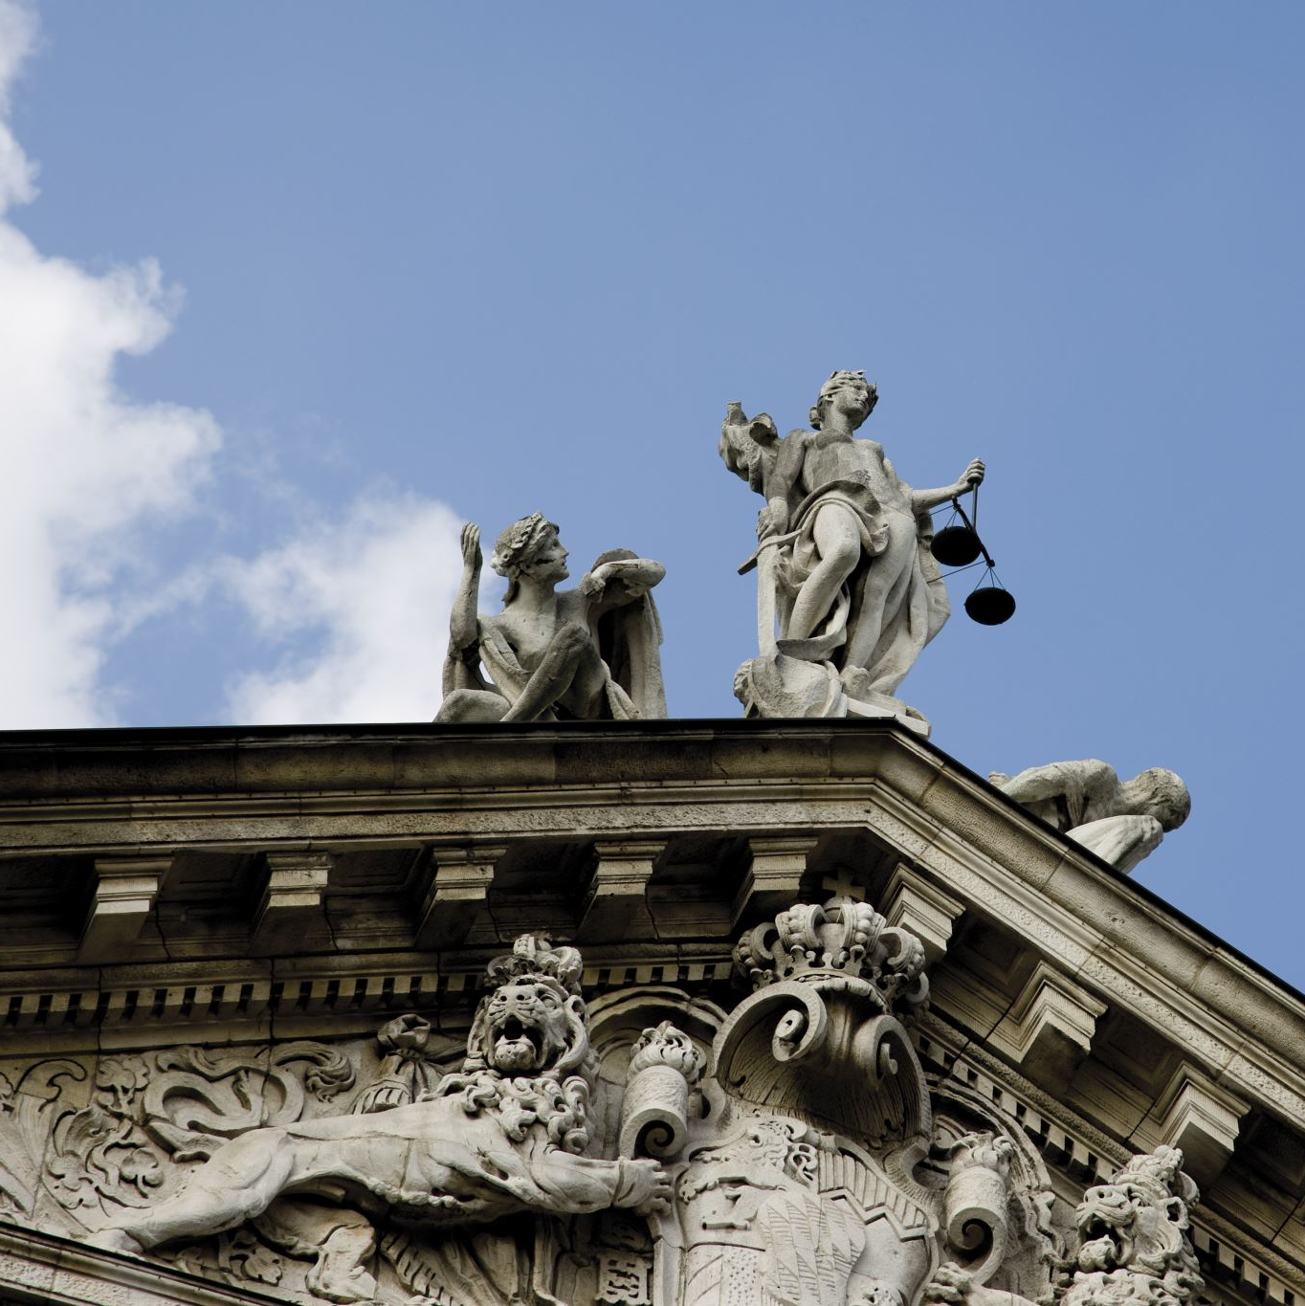
III. AI in Employment Litigation
AI Chat Logs as Evidence in Discovery
Are AI Chat Logs Privileged
Waiving Solicitor-Client Privilege with AI

Slide 25
  AI Chat Logs are a “Document”
B.C. Supreme Court Civil Rules
In litigation, parties are required to produce (Rule 7-1(1)):
  all documents that are or have been in the party's possession or control and that could, if available, be used by any party of record at trial to prove or disprove a material fact; and
  all other documents to which the party intends to refer at trial.
Rule 1-1(1): “Document" has an extended meaning and includes a photograph, video, recording of sound, any record of a permanent or semi-permanent character and any information recorded or stored by means of any device
Rule 7-2(18): “a person being examined for discovery must answer any question within the person's knowledge or means of knowledge regarding any matter, not privileged, relating to a matter in question in the action"

Slide 26
  AI Chat Logs May Be Evidence in Litigation
In B.C. civil litigation:
AI chat logs may be producible documents
Parties may try to hide AI chat logs by arguing they are privileged (solicitor-client or litigation privilege)
You may be called to testify about your AI chat logs or the AI chat logs of your organization
Duty to preserve evidence. Do not intentionally delete AI chat logs because of litigation
Notes:
Solicitor-Client Privilege
There must be a communication (oral or written);
The communication must be of a confidential character;
The communication must be between a client (or their agent) and a legal advisor; and
The communication must be directly related to the seeking, formulating, or giving of legal advice
Litigation Privilege
Documents in question must have been created:
In contemplation of litigation which is “in reasonable prospect; and
For the “dominant purpose” of use in the litigation.

Slide 27
  Court Decisions on Producing AI Chat Logs
No reported case in Canada currently (to our knowledge) deciding whether AI chat logs are producible
Cases in the USA and the UK have mixed results. Some protect AI chat logs from production in civil litigation on the basis of litigation privilege
In the USA and UK cases, many of the parties were self-represented litigants who used AI during litigation or at the direction of legal counsel. The dominant purpose of the chat was for litigation

Slide 28
  Internal AI Logs of HR are Likely Producible
AI chat logs about internal decision-making HR processes and rationales which precede litigation are likely producible in litigation if:
  they prove or disprove a material fact in the litigation; and
  the log was not created for the dominant purpose of litigation
Example: In cases of just cause or discrimination, the first time or sequence of when performance concerns or medical accommodation measures were raised or documented can be material facts. AI logs which prove or disprove a sequence of events or provide insight to the employer’s intention or internal analysis can be material facts
Notes:
If litigation was not contemplated or active at the time of the AI prompt/log, it will be difficult to fulfill Criteria #2 and therefore a standard internal chat log about a mid-employment HR decision regarding that employee would likely NOT be covered by privilege. It would therefore be producible.

Slide 29
  Waiving Solicitor-Client Privilege Through AI
Legal advice from a lawyer is covered by solicitor-client privilege
Privilege can be waived by an intention to do so or by implication
Uploading legal advice into AI can waive privilege over the underlying legal advice because:
  AI is a third party that may not have sufficient confidentiality terms of use
  AI could use your inputs more generally (i.e. open vs. closed AI)
  Privilege is premised on an intention to keep communications confidential

Slide 30
  UK Example of Waiving Privilege
UK v Secretary of State for the Home Department [2026] UKUT 81 (Hamid)
“[U]ploading confidential documents into an open source AI tool such as ChatGPT is to place this information on the internet in the public domain and […] waive legal privilege”
“Closed source AI tools which do not place information in the public domain, such as Microsoft Copilot, are available for tasks such as summarising without these risks.”
Courts and Tribunals Judiciary of England and Wales: “Any information that you input into a public AI chatbot should be seen as being published to all the world”
Notes:
Hamid joined together two cases which related to lawyers using AI which hallucinated or fabricated case law
The Upper Tribunal (Immigration and Asylum Chamber) ruled that open-source AI will waive solicitor-client privilege.

Slide 31
CSSEA 2026 AGM and Conference
AI and the Law
October 15, 2026
Matthew Cooperwilliams & Joshua Ghatak
Cooperwilliams Truman & Ito LLP

