Slide 1

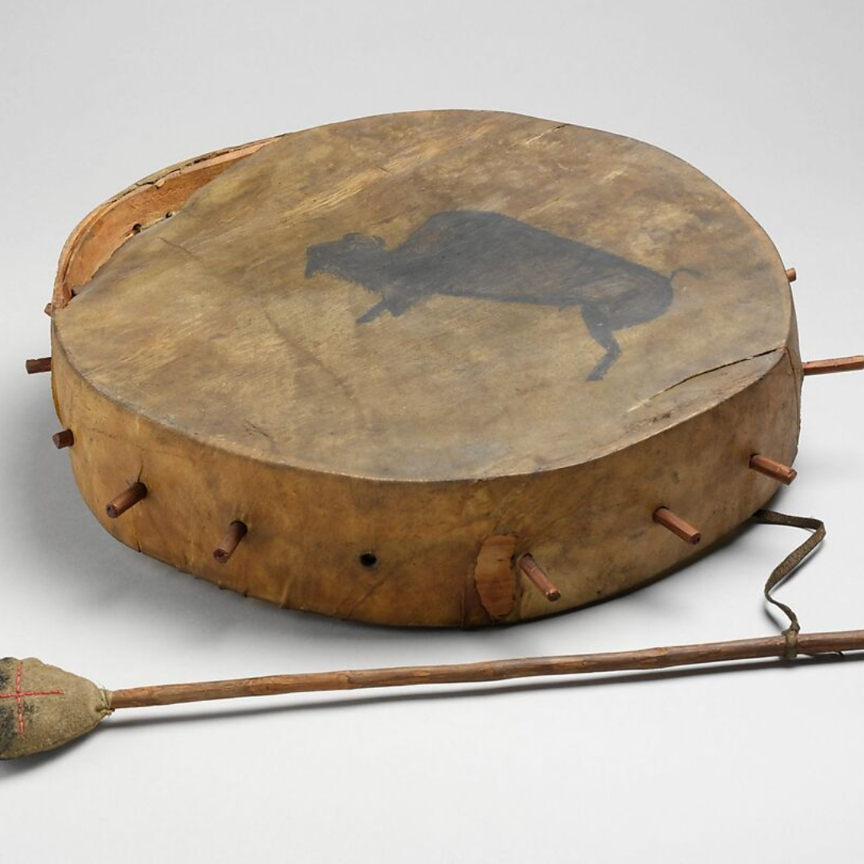
Indigenous Education Consultant
Presented by Aaron Rivard

Slide 2

Westcoast Family Centres is privileged to offer person-centered services on the unceded territory of the kʷikʷəƛ̓əm (Kwikwetlem) First Nation, q̓ic̓əy̓ (Katzie) First Nation, Kwantlen First Nation, and the Coast Salish People including the territories of the xʷməθkʷəy̓əm (Musqueam), Skwxwú7mesh Úxwumixw (Squamish), and səl̓ilwətaɁɬ (Tsleil-Waututh) Nations.​
​
Our agency stands in solidarity with all Indigenous Nations to repatriate their children back to their home communities ​
and nations.

Slide 3
MISSION
VISION
Westcoast Family Centres Society strengthens relationships between children and families and between families and their communities.
All families reach their full potential.

Slide 4

OUR
LOCATIONS
Vancouver
Tri-Cities
North Shore
Ridge Meadows

Slide 5



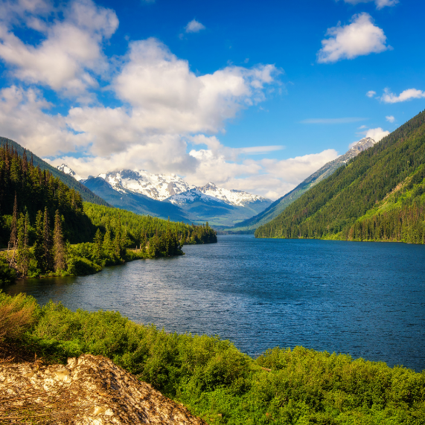

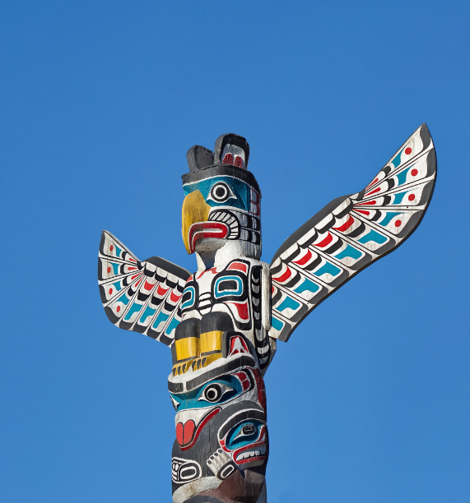
CONTENT
1
History of Turtle Island, First Nations People of Canada & Languages
2
Royal Proclamation / Indian Act
3
History of Residential Schools / 60’s Scoop & Our Current Foster Care Systems
4
Starlight Tours
5
Allyship – Call In Call Out Language
6
TRC 94 Calls to Action
7
Creating Connection & Belonging
8
Indigenizing WFC
9
Discussion & Closing Prayer

Slide 6
History of Turtle Island, First Nations People of Canada & Languages
In 1492, approximately 100 million Indigenous People lived in Turtle Island in North America
Within the first 25 years of Columbus arriving, 18 million people died from various reasons
Today, there is approximately 1.6 million Indigenous people living in Canada
From the time of first contact, to current, over 90 million Indigenous people have passed away for various reasons
In the United States, there is approximately 5 million First Nations & Indigenous people currently residing there
In Canada, there is approximately 630 First Nations communities in Canada, which represent more than 50 Indigenous Nations. There is approximately 125 different Indigenous languages in Canada
In British Columbia, we have approximately 202 Nations living in BC, with 70 different languages
All families reach their full potential.

Slide 7
Royal Proclamation / Indian Act
In 1834, the first Residential Schools opened in the United States
In 1867, Canada had the Royal Proclamation
In 1880, the Indian Act came into effect in Canada
This started the forced removal of Indigenous children from their families and placed them into Residential Schools, similar to ones in the United States
All families reach their full potential.

Slide 8
History of Residential Schools / 60’s Scoop & Our Current Foster Care Systems
The 60’s Scoop started in the 1960’s and did not end until the 1980s
The last Residential School in Canada closed in 1997
In 2021, at the Kamloops Indian Residential School, the remains of 215 Indigenous children were found buried on the property
On September 30th, 2021, Canada created a statutory holiday called National Day for Truth & Reconciliation to honor these victims of the Residential School system
September 30th is also known as Orange Shirt Day, inspired by Phyllis Webstad
All families reach their full potential.

Slide 9
Starlight Tours
Starlight Tours are when Indigenous Peoples are picked up by police and driven out of town, their shoes are removed and overrepresented walk back to home in freezing cold temperatures
In past and current corrections, First Nations men and women are still overrepresented in our correction facilities, when only approximately 4.9% of Canada’s population is First Nations, yet within our prison systems First Nations represent approximately 70% of people incarcerated
All families reach their full potential.

Slide 10
Allyship – Call In Call Out Language
How do we create allyship?
We need to take the time to learn about Canada’s history of Indigenous people and how they have been treated, Residential School systems, and the 60’s Scoop, and the resulting effects of these systems
We need to create safe places for learning and sharing
We stand alongside our First Nations brothers and sisters in their journey to reconcile and heal from past atrocities
Call In: When safe to do so, we can meet with said individuals or groups of people to discuss what needs to be changed
Call Out: When we see something, we address it in the here and now, when it is safe to do so
All families reach their full potential.

Slide 11
TRC 94 Calls to Action
In 2012, Truth and Reconciliation Commission of Canada was formed to address the atrocities of what happened to the First Nations peoples of Canada and the systems that supported this
In 2015, the 94 Calls to Action came into effect
The first five Calls to Action refer to our child welfare system.
“We have described for you a mountain, we have shown you the path to the top. We call upon you to do the climbing.”
-Senator Murray Sinclair
Truth and Reconciliation Chair, June 2015
All families reach their full potential.

Slide 12
TRC 94 Calls to Action
1. We call upon the federal, provincial, territorial, and Aboriginal governments to commit to reducing the number of Aboriginal children in care by: (ii) Providing adequate resources to enable Aboriginal communities and child-welfare organizations to keep Aboriginal families together where it is safe to do so, and to keep children in culturally appropriate environments, regardless of where they reside.
2. We call upon the federal government, in collaboration with the provinces and territories, to prepare and publish annual reports on the number of Aboriginal children (First Nations, Inuit, and Métis) who are in care, compared with non-Aboriginal children, as well as the reasons for apprehension, the total spending on preventive and care services by child-welfare agencies, and the effectiveness of various interventions.
All families reach their full potential.

Slide 13
TRC 94 Calls to Action
3. We call upon all levels of government to fully implement Jordan’s Principle.
4. We call upon the federal government to enact Aboriginal child-welfare legislation that establishes national standards for Aboriginal child apprehension and custody cases and includes principles that: (iii) Establish, as an important priority, a requirement that placements of Aboriginal children into temporary and permanent care be culturally appropriate.
5. We call upon the federal, provincial, territorial, and Aboriginal governments to develop culturally appropriate parenting programs for Aboriginal families.
All families reach their full potential.

Slide 14
Creating Connection & Belonging
How do we create connection and belonging when so much has been lost?
Supporting First Nations peoples of Canada to learn and preserve their languages, traditions, culture, and their connection with their nation, band, and Mother Earth
This includes creating opportunities for child and adults to learn about who they are, where they come from, and who they are connected to
All families reach their full potential.

Slide 15

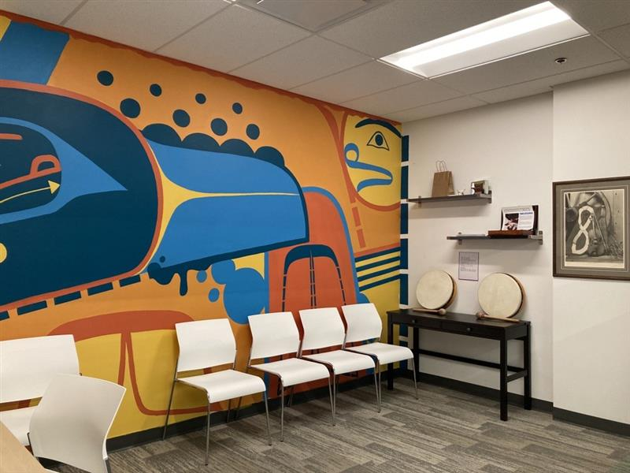
Indigenizing WFC
Indigenous Education Consultant position
Indigenous Learning & Sharing Circle
TRC Learning & Sharing Circles
Raven Room
Smudging
Updating Forms
Staff Trainings

Slide 16
Question and
Discussion Space
How do we create our own Acts of Reconciliation on September 30th within our agencies we work for/within ourselves/all year around (i.e. wear our Orange Shirt throughout the year)
All families reach their full potential.

Slide 17
Take-Away Questions
How do we hold the discomfort of what we’re learning, while recognizing our own relationship to systems that have caused harm?
Land Acknowledgements: What is the purpose of doing them and who does them?
All families reach their full potential.

Slide 18
What’s Next?
Be curious! Be flexible!
Attend Indigenous events. If you know about it, it’s an invitation.
Follow social media accounts
  National Centre for Truth and Reconciliation (NCTR)
  Orange Shirt Society
Watch documentaries
  Phyllis's Story (National Film Board of Canada)
  Finding Dawm (National Film Board of Canada)
Support Indigenous businesses
  Salmon n' Bannock (Bistro)
  Massy Books (Bookstore)
  Sisters Sage (Health and Wellness)
  Native By Nature (Clothing and Apparel)
All families reach their full potential.

Slide 19
DISCUSSION &
CLOSING PRAYER

Slide 20




CONTACT
US
Phone
604-254-5457
Website
www.westcoastfamily.org
WestcoastFamilyCentres
westcoastfamctr
Westcoast Family Centres Society

